Slide 1
Object Localisation
Group G9

Slide 2



Introduction
Object Localisation is the task of finding objects in images and describing them using rectangles.
Given an image, an object localisation model should output co-ordinates which describe the size and location of each object in the image.
In our Project we combine the localisation task with the task of classification.
Hence the aim of our model is to both locate objects and label what the object is.
This task is known as object detection.

Slide 3
Project Structure
We split the project into the following structure:
1. Describe the dataset
2. Research and Create Models
3. Model tuning
4. Collecting results and analysis

Slide 4
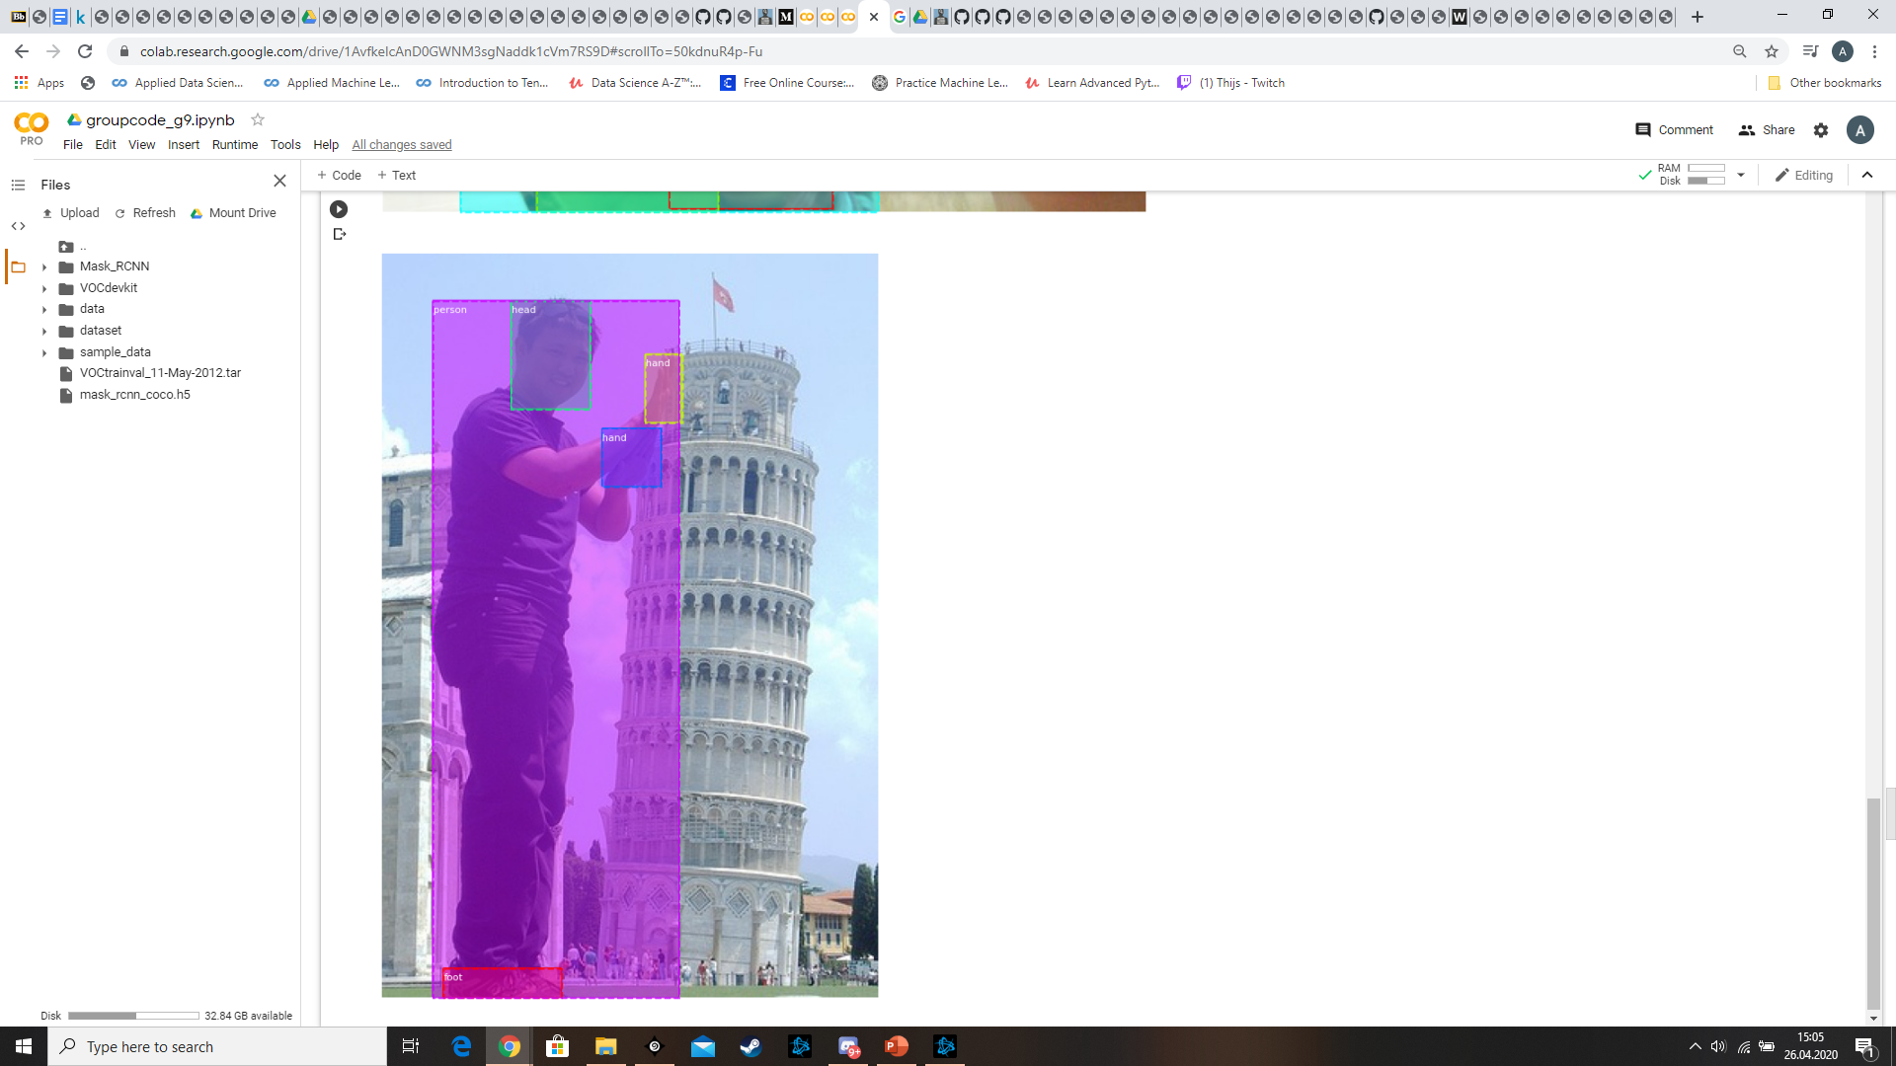
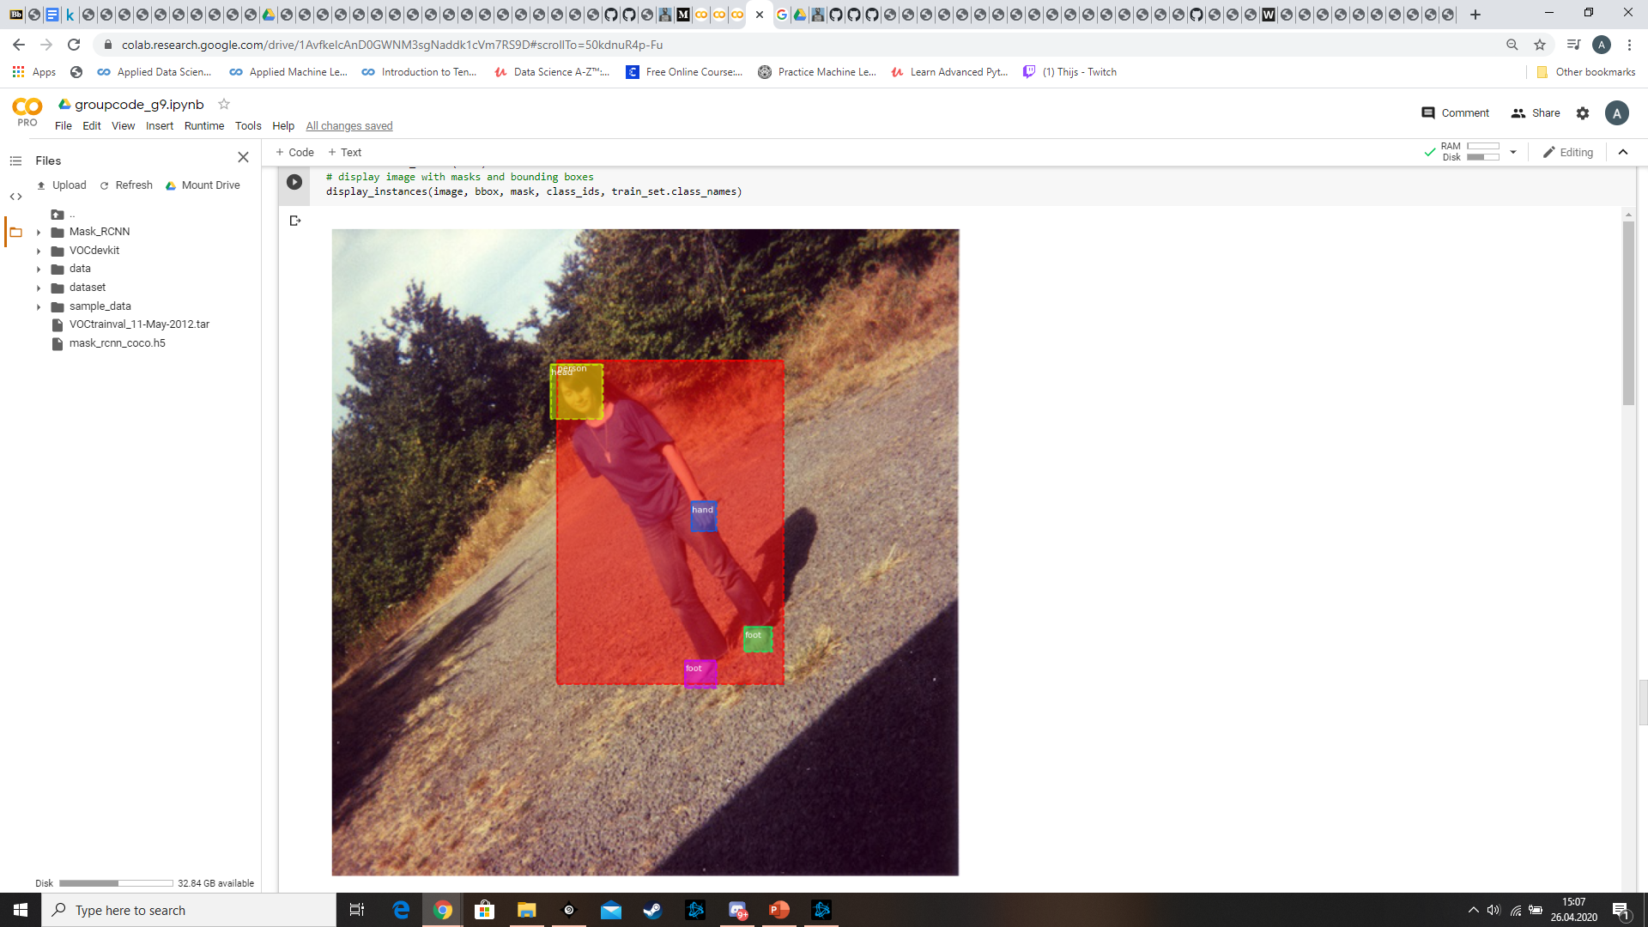
Description of the dataset
The first task involved looking at the dataset provided and choosing what images we would use.
From here we decided to perform the task of object detection using images of people.
We would try to locate and classify the following objects:
People, Heads, hands and Feet.

Slide 5
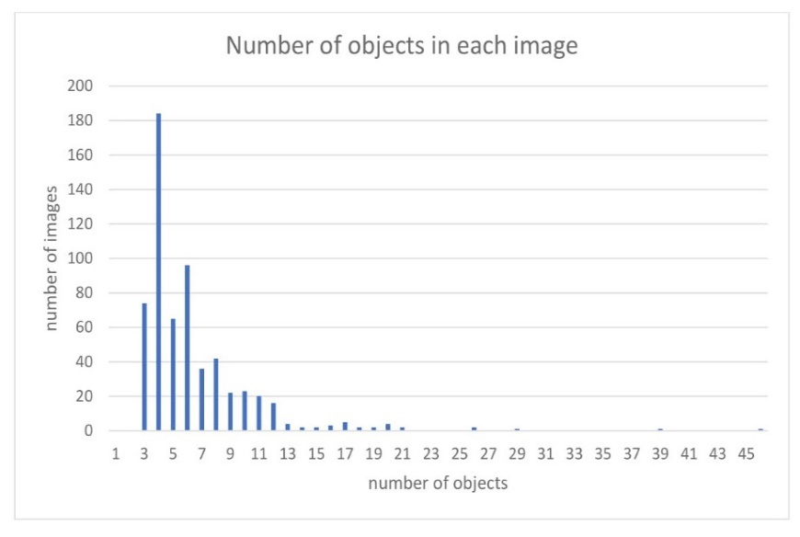
Analysis of the dataset
Analysis of the annotations for the images, showed that there were other labelled objects, sofas, chairs, tables, etc … inside the images.
These were removed as they did not fit with our objective and there were not enough instances of them to train a model.
We also analysed the number of images that
contained different numbers of objects.
This allowed us to find if there were any images
with many objects and hence any images that
may be difficult to perform accurate object
detection.

Slide 6
Researched Methods
Simple CNN : It can only detect one object with the bounding box a time.
Used for exploring underlying techniques.
Mask R-CNN : Extract features for the entire image once.
Use a separate fully convolution network to predict objects.
Output object mask that supports better performance.
YOLOv3 : Find all objects in an image grid at one time, You Only Look Once.
Process full images and optimise detect performance simultaneously.
Xception : Depthwise Separable Convolutions.
Cross-channel and spatial correlations in the feature maps can be decoupled
Model | Mask R-CNN | YOLOv3 | Xception
mAP | 0.77 | 0.56 | 0.62

Slide 7
Chosen Method：Mask R-CNN
Steps:
1. Installation of the Mask R-CNN Library.
2. Data preprocessing : annotation (class and bounding box of image) and masks.
3. Create training and testing dataset based on 75/25 split.
4. Model training : transfer learning → record loss → adjust model
5. Model experimental setting
6. Model evaluation and prediction of test images.

Slide 8
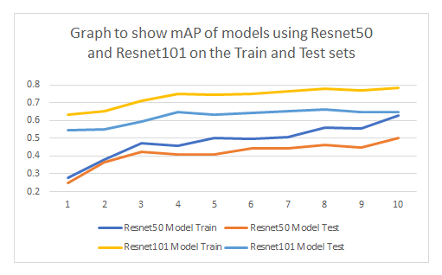
Mask R-CNN Experimental Setting
Here the aim was to increase the performance of the model by tuning different parameters.
This included:
. Loss Weights
. Learning rate / Momentum
. Regularisation parameter
. Model Layers
. Model Backbone

Slide 9
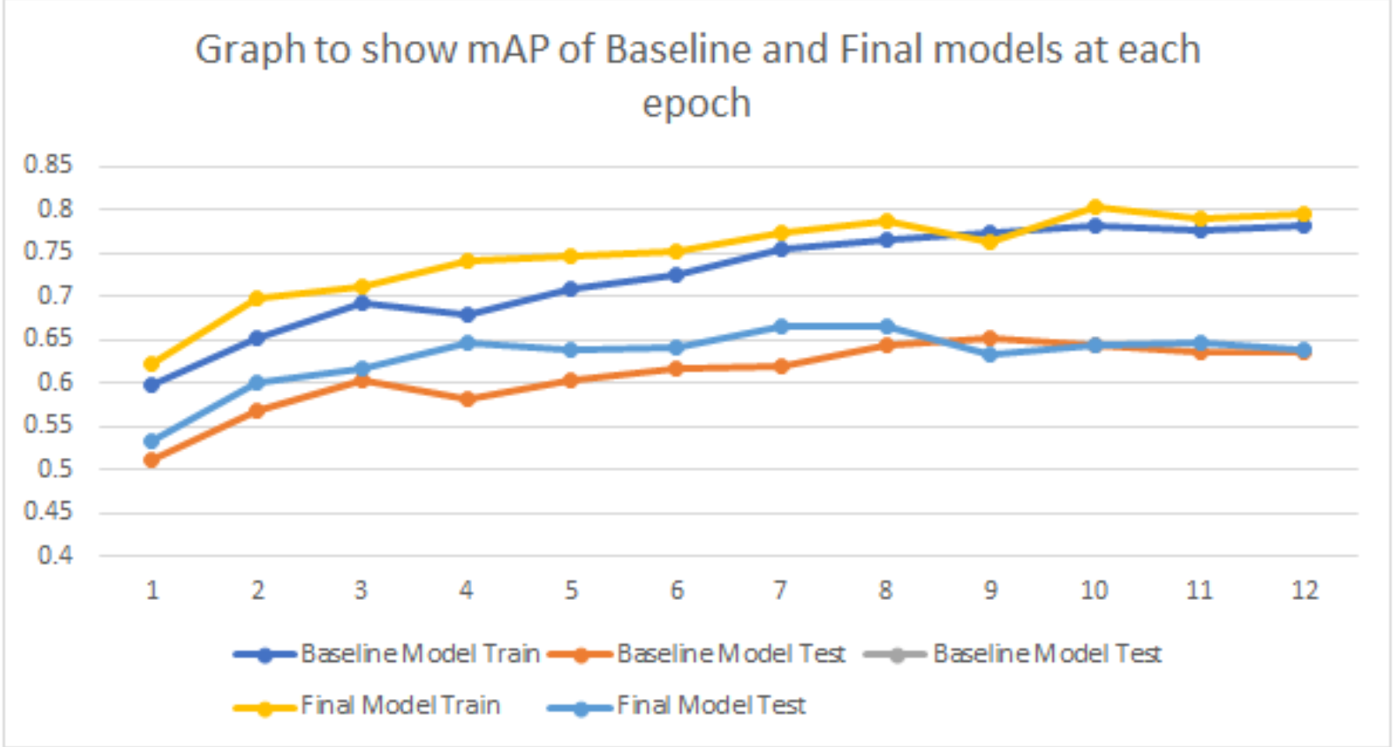
Results
Mean Average Precision Metric
A common and accepted way of evaluating models for object detection.

Slide 10
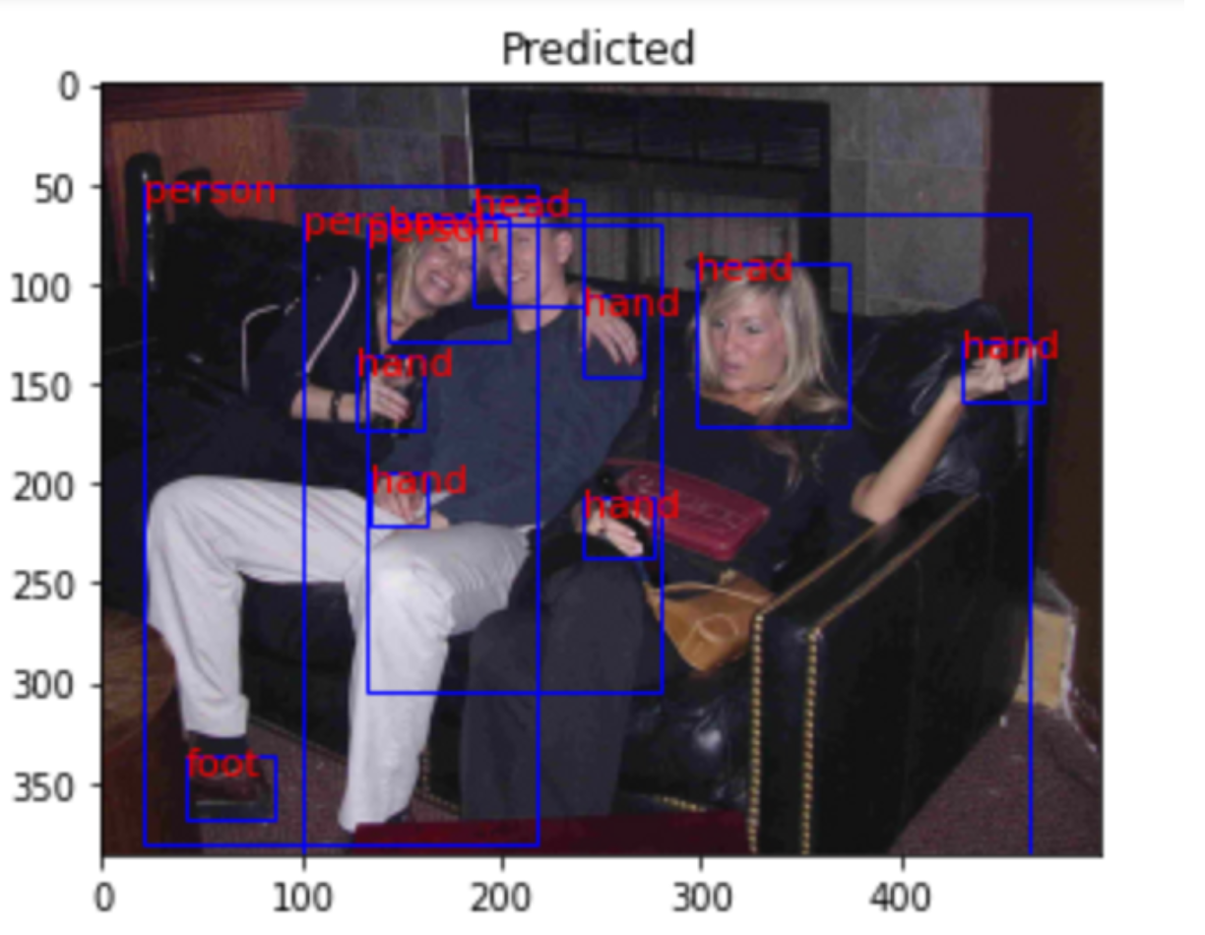
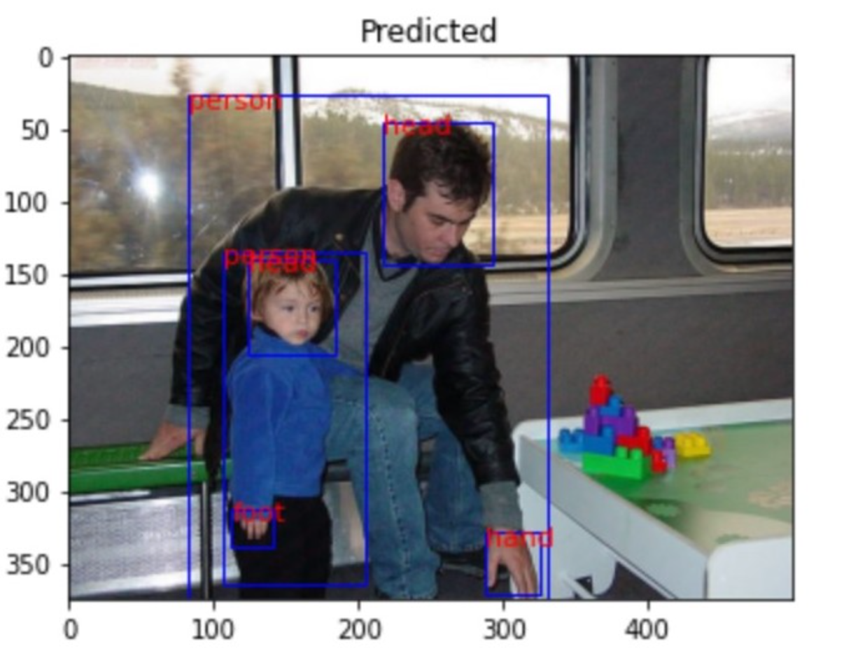
Analysis
The model performed very well in locating people.
Able to learn to detect and classify objects.
Figures shows some of these instances where the model has made some excellent predictions.

Slide 11
Conclusion
The Mask R-CNN model that we created and trained performed very well
The visual results seemed very promising.
In this project, we mostly have created and trained a Mask R-CNN model with the specific VOC2012 dataset.
Demonstrate the efficiency of our model.
Also showed how the variation in IoU threshold changes.

Slide 12
Thank You

